Slide 1
Module 1 — Foundations
Core concepts of Java Exceptions and Error Handling

Slide 2
Table of Contents
₁ What is an Exception?
₂ Call Stack and Propagation
₃ The Throwable Hierarchy
₄ Lab Activity
₅ Checkpoint Quiz

Slide 3
What is an Exception?
An exception is an event that disrupts the normal flow of the program. It typically occurs due to an error during execution, such as invalid input or resource failure.
What are Errors?
The error signifies a situation that mostly happens due to the absence of system resources. The system crash and memory errors are an example of errors. It majorly occurs at runtime.
Basis | Exception | Error
Nature | Caused by incorrect code or external factors | Caused by system failure or resource limitation
Recoverable | Usually recoverable | Generally not recoverable
Handling | Can be caught using try-catch blocks | Should not be handled (indicates serious issue)
Examples | NullPointerException, IOException, ArithmeticException | OutOfMemoryError, StackOverflowError

Slide 4
Types of Exceptions in Java
Checked Exceptions
➡ Description:
Checked by the compiler at compile time.
If not handled properly, the program won’t compile.
Represent external conditions that are beyond the program’s control, such as file handling, network communication, or database access.
Must be handled using a try-catch block or declared using the throws keyword.
🧮 Examples:
IOException
SQLException
FileNotFoundException
ClassNotFoundException

Slide 5
Types of Exceptions in Java
Unchecked Exceptions
➡ Description:
Also called Runtime Exceptions.
Not checked by the compiler during compile time.
Occur because of programming mistakes such as logical or arithmetic errors.
The program compiles successfully but fails during execution.
Can be handled using try-catch, but not mandatory.
🧮 Examples:
NullPointerException
ArithmeticException
ArrayIndexOutOfBoundsException
NumberFormatException

Slide 6
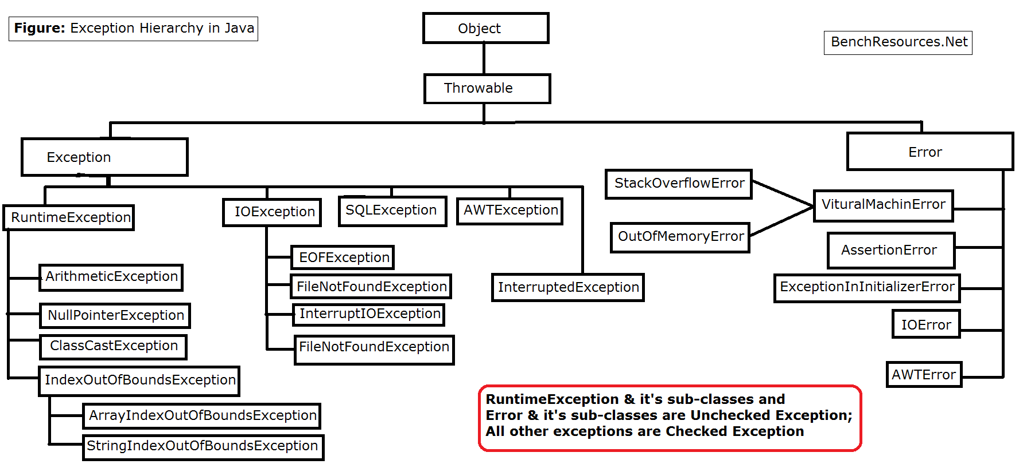
Exception Hierarchy

Slide 7
Exception Hierarchy
Throwable: The superclass for all errors and exceptions in Java.
Error: Represents serious problems that applications should not catch.
Exception: Indicates conditions that a reasonable application might want to catch. RuntimeException: A subclass of Exception that is unchecked and often indicates programming bugs.

Slide 8
What is Exception Handling?
Definition:
Exception Handling is a mechanism in Java to handle runtime errors so that the normal flow of the application can be maintained.
Purpose:
To detect and respond to unexpected events (like division by zero, invalid input, or file not found) gracefully.
Advantages of Exception Handling
✅ Separates error-handling code from regular logic
✅ Improves program reliability and stability
✅ Simplifies debugging and maintenance
✅ Allows the program to continue execution after handling an error

Slide 9
Call Stack and Propagation
What is a Call Stack?
The call stack in Java is a runtime structure that stores information about method calls.
It uses the LIFO (Last In, First Out) principle.
Each active method call creates a stack frame containing:
  Method parameters
  Local variables
  Return address
How the Call Stack Works
A method is called → a new stack frame is pushed onto the stack.
When the method returns, its stack frame is popped off.
The JVM automatically manages this process.

Slide 10
Call Stack and Propagation
What is a Call Stack?
The call stack in Java is a runtime structure that stores information about method calls.
It uses the LIFO (Last In, First Out) principle.
Each active method call creates a stack frame containing:
  Method parameters
  Local variables
  Return address
How the Call Stack Works
A method is called → a new stack frame is pushed onto the stack.
When the method returns, its stack frame is popped off.
The JVM automatically manages this process.

Slide 11
Call Stack and Propagation
Visualization:
Example Code (Normal Execution)
Stack (Top → Bottom) | Description
C() | Currently executing method
B() | Caller of C()
A() | Main caller
class CallStackExample {
static void A() {
B();
}
static void B() {
System.out.println("Inside method B");
C();
}
static void C() {
System.out.println("Inside method C");
System.out.println(10/0);
}
public static void main(String[] args) {
A();
}
}
Flow:
main() calls A() → A() frame pushed
A() calls B() → B() frame pushed
B() calls C() → C() frame pushed
C() executes → returns → frames popped in reverse order

Slide 12
Exception Handling Keywords
Keyword | Purpose
try | Block of code where exception might occur.
catch | Handles the exception type.
finally | Executes code regardless of exception (cleanup).
throw | Used to explicitly throw an exception.
throws | Declares exceptions in a method signature.

Slide 13
Try and catch block
1. try block
The try block contains code that may throw an exception.
If an exception occurs, normal execution stops, and control passes to the appropriate catch block.
try {
// Code that might cause an exception
}
try {
int result = 10 / 0; // ArithmeticException
}

Slide 14
Try and catch block
2. catch block
The catch block handles the specific type of exception that occurred.
You can have multiple catch blocks to handle different exceptions separately
catch (ExceptionType e) {
// Code that handles the exception
}
try {
int result = 10 / 0;
}
catch (ArithmeticException e) {
System.out.println("Error: Division by zero!");
}

Slide 15
Try , catch and finally block
3. finally block
The finally block contains code that always executes, whether an exception occurs or not.
Commonly used for cleanup tasks (like closing files, releasing resources, or disconnecting from databases).
try {
int[] numbers = {1, 2, 3};
System.out.println(numbers[5]); // Will throw ArrayIndexOutOfBoundsException
}
catch (ArrayIndexOutOfBoundsException e) {
System.out.println("Error: Array index is out of bounds.");
}
finally {
System.out.println("This block always executes.");
}
finally {
// Code that always executes (optional)
}
Output:
Error: Array index is out of bounds.
This block always executes.

Slide 16
Example: Division with Exception Handling
public class SimpleExample {
public static void main(String[] args) {
try {
int a = 10;
int b = 0;
int result = a / b; // This will cause an exception
System.out.println("Result: " + result);
}
catch (ArithmeticException e) {
System.out.println("Error: Cannot divide by zero!");
}
finally {
System.out.println("Program finished.");
}
}
}
Output
Error: Cannot divide by zero!
Program finished.

Slide 17
Example: Accessing an Invalid Array Index
public class ArrayExample {
public static void main(String[] args) {
try {
int[] numbers = {10, 20, 30};
System.out.println("The number is: " + numbers[5]); // Invalid index
}
catch (ArrayIndexOutOfBoundsException e) {
System.out.println("Error: You tried to access an invalid array index!");
}
finally {
System.out.println("Program finished.");
}
}
}
Output
Error: You tried to access an invalid array index!
Program finished.

Slide 18
Multiple try-catch blocks
public class MultipleCatchExample {
public static void main(String[] args) {
try {
int[] numbers = {10, 20, 30};
int a = 10, b = 0;
// This line may throw an ArithmeticException
int result = a / b;
// This line may throw an ArrayIndexOutOfBoundsException
System.out.println("Number: " + numbers[5]);
}

Slide 19
Multiple try-catch blocks
catch (ArithmeticException e) {
System.out.println("Error: Division by zero!");
}
catch (ArrayIndexOutOfBoundsException e) {
System.out.println("Error: Invalid array index!");
}
catch (Exception e) {
System.out.println("Some other error occurred: " + e.getMessage());
}
finally {
System.out.println("Program finished.");
}
}
}

Slide 20
Print Exception Information
1. Using getMessage()
Prints only the message associated with the exception.
try {
int a = 10 / 0;
} catch (ArithmeticException e) {
System.out.println("Error: " + e.getMessage());
}
Output:
Error: / by zero
2. Using toString()
Prints the exception class name along with the message.
try {
int a = 10 / 0;
} catch (ArithmeticException e) {
System.out.println(e.toString());
}
Output:
java.lang.ArithmeticException: / by zero

Slide 21
Print Exception Information
3. Using printStackTrace()
Prints the full stack trace, showing exactly where the exception occurred in the code.
try {
int a = 10 / 0;
} catch (ArithmeticException e) {
e.printStackTrace();
}
Output:
java.lang.ArithmeticException: / by zero
at Main.main(Main.java:4)
Custom Message with Exception
You can combine your own message with exception info for clarity.
try {
int a = 10 / 0;
} catch (ArithmeticException e) {
System.out.println("Something went wrong! " + e);
}
Output:
Something went wrong! java.lang.ArithmeticException: / by zero

Slide 22
Thank You!

